Slide 1

Neural network
by Phani musunuri

Slide 2
Agenda:
Introduction to neural network
Activation function
Optimizers
Pros& cons
Neural-network approach to the auto mpg data
Introduction to data
Eda
Experiment
Conclusion
Neural-network approach to the hepatitis data
Introduction to data
Eda
Experiment
conclusion

Slide 3
What is neural network?
A neural network is an algorithms that endeavors to recognize underlying relationships in a set of data through a process that mimics the way the human brain operates.
Neurons are at the heart of deep learning algorithms. Their name and structure are inspired by the human brain, mimicking the way that biological neurons signal to one another.
Types of neural network:
Feed forward Neural Networks
Convolution Neural Networks (CNN)
Recurrent Neural Networks (RNN).

Slide 4
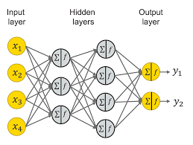
Artificial neural networks (ANNs) are comprised of an input layer, one or more hidden layers, and an output layer.
Each node, or artificial neuron, connects to another and has an associated weight and threshold.

Slide 5
Forward propagation:
Forward propagation refers to storage and calculation of input data which is fed in forward direction through the network to generate an output.
It is the way to move from the Input layer (left) to the Output layer (right) in the neural network.
Backward propagation:
The process of moving backward from the Output to the Input layer is called the Backward Propagation.
It is used to update the weights.
Epochs:
An epoch means training the neural network with all the training data for one cycle
Loss function:
It finds the difference between predicted & actual outcome

Slide 6
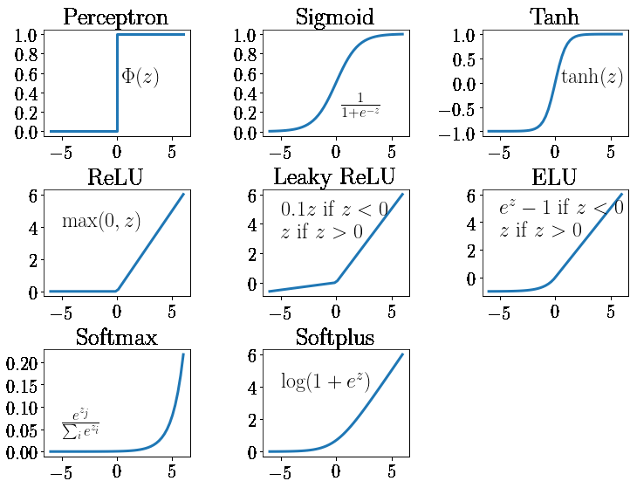
ACTIVATION FUNCTION:
An activation function in a neural network defines how the weighted sum of the input is transformed into an output.
For the Binary classification problem we use
Relu , pre relu in the hidden layer and for the output we use sigmoid activation function.
For the multi class classification problem we use
Relu , pre relu in the hidden layer and for the output we use SoftMax activation function
For the Regression problem we use Relu , pre relu in the hidden layer and for the output we use Linear activation function

Slide 7
optimizers:
An optimizer is a function or an algorithm that modifies the attributes of the neural network, such as weights and learning rate. Thus, it helps in reducing the overall loss and improve the accuracy.
Optimizers will make sure that each and every weight will get updated in back propagation
SGD
Mini batch SGD
SGD with momentum
Ada grad
Rms prop
Adam optimizer.
Adam optimizer has adaptive learning rate & momentum.

Slide 8
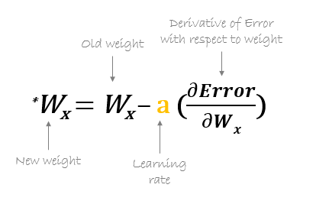
Weights:
Weights will actually help your neurons to activated at what level it should be activated
Weights say how much neurons can be activated/deactivated
Learning rate:
Learning rate is a hyper-parameter that controls the weights of our neural network with respect to the loss gradient.
It defines how quickly the neural network updates the concepts it has learned.

Slide 9
ADVANTAGES:
Efficiency
Continuous Learning
Multitasking is one of the common advantages of Neural Networks
The ability of parallel processing
DISADVANTAGES:
Hardware dependent
Black Box Nature
Approximate Results
Long training processes

Slide 10
Application of neural networks:
These artificial neurons function in a way similar to the human brain.
They can be used for image recognition, character recognition and stock market predictions.
Weather forecasting
Healthcare
Defence
Aerospace
In this project we use artificial neural network (ANN) to give better estimates for the two use cases:
auto-mpg(regression)
Hepatitis(classification)

Slide 11
Neural network approach for the auto-mpg
Regression problem

Slide 12
Background:
The automotive industry is extremely competitive. With increasing fuel prices and picky customers, automobile makers are constantly optimizing their process to increase fuel efficiency
Problem statement:
In this project we will train an Artificial Neural Network (ANN) to give better estimates for MPG rates all over the automobile industry. Such calculation would help to reduce the efforts needed to design and analyze automobile fuel consumption with such limited factors "attributes (cylinders, displacement factor, horsepower, weight, acceleration, model year and origins of manufacturing).

Slide 13
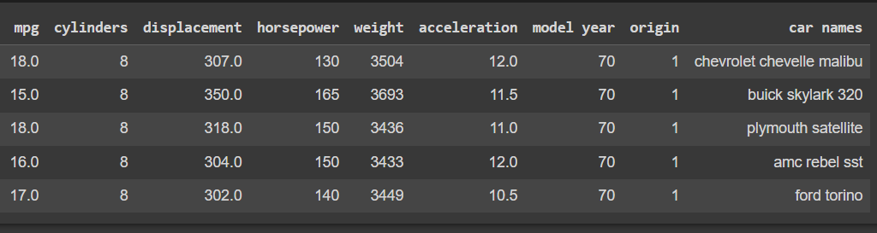
Data & quality check:
In this data we have 9 attributes and 398 observations.
Attributes present in the data set are Horsepower, Acceleration, Cylinders, Displacement, Weight, MPG, Car name, Origin, Model year.

Slide 14
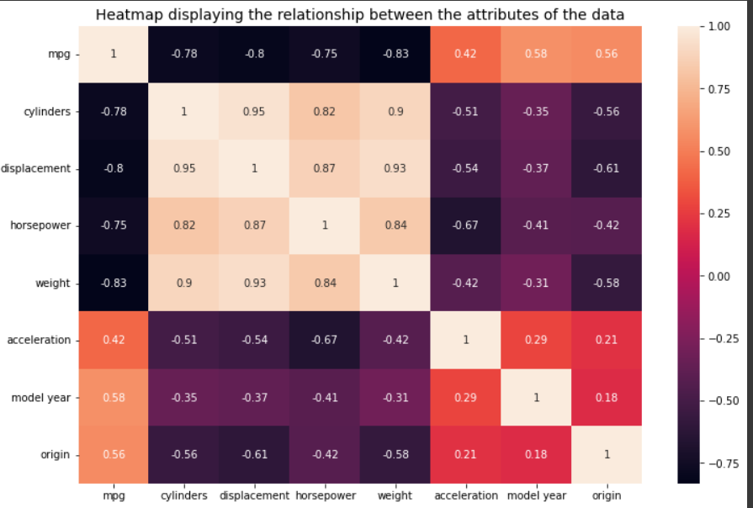
EDA Insights:
HEAT MAP:

Slide 15
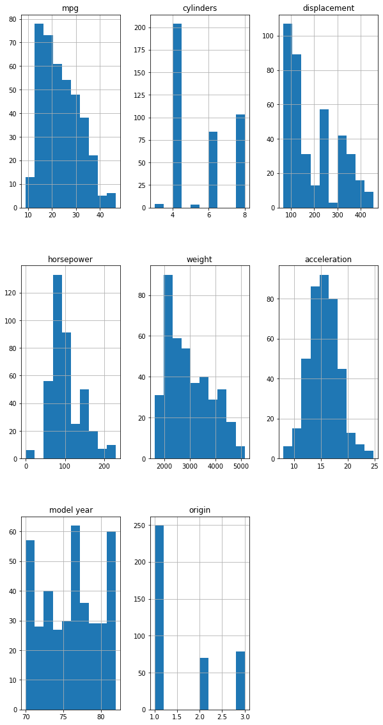
Histogram:

Slide 16
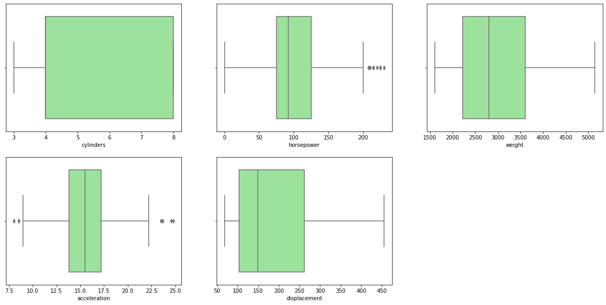
Box plot:

Slide 17
Train& test:
In train & test split we did experiment with several sizes like (60%,40%), (70%,30%), (75%,25%), (80%,20%),
ANN training used 80% of the 398 cases and 20% of the cases are selected for the testing.
Model fit:
We fit the model using ANN
Optimizers used in the neural network are SGD & Adam.
Different architectures& epochs considered to get the better estimates.
MAE is taken as the loss function

Slide 18
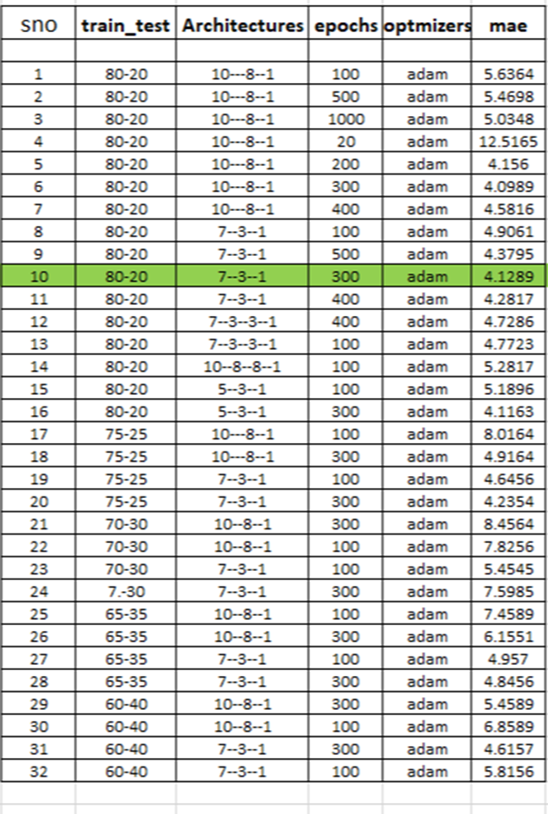
To get the best result we perform lot of experiment by considering different test size , architecture, epochs, optimizers

Slide 19
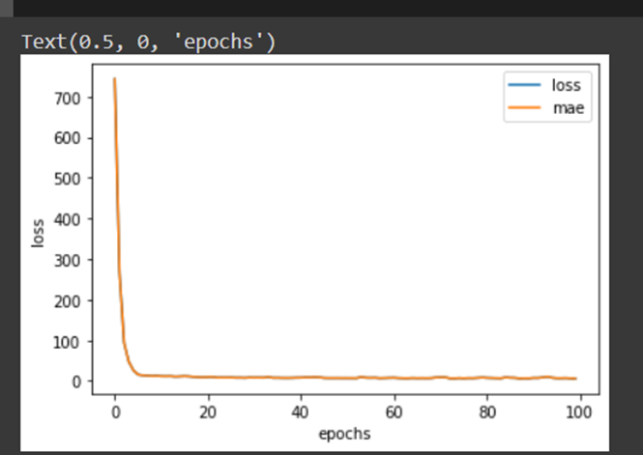
The graph represents the performance of ANN model

Slide 20
Conclusion:
An artificial Neural Network model for the auto-mpg was presented.
We got the best result for neural network which consists of Single input layer (7 inputs), a hidden layer (3 inputs) and a single Output layer .
After observing the graph, after some epochs the loss is parallel to x axis .There is no big difference in the loss.
The model was tested and got the lowest Mae.

Slide 21
Neural network approach for the hepatitis data
Classification problem

Slide 22
BACKGROUND :
Hepatitis is an swelling of the liver. Viral hepatitis is major public health concern, 10 million cases occur worldwide.
OBJECTIVE:
The purpose of this project is to use the dataset for the diagnosis of hepatitis using an Artificial Neural Network(ANN).
This project presents an artificial neural network based approach for the diagnosis of hepatitis virus
THE PATH:
A dataset is provided and the class variable is analyzed to predict the person either die/live .

Slide 23
INTRODUCTION TO DATASET
Data Contains 19 Attributes and 155 Observations.
A number of factors that may possibly influence the performance of patients were outlined. Such factors as age, sex, Steroid, Antivirals, Fatigue,Malaise, Anorexia, Liver Big, Liver Firm Splean Palpable, Spiders, Ascites, Varices, Bilirubin, Alk Phosphate, SGOT, Albumin,Protein and Histology, were then used as input variables for the ANN model
The output variable represents the diagnosis of hepatitis by knowing the probability of survive or
death of the patient.
No of Categorical variables are 13 .
No of continuous Variables are 6.

Slide 24
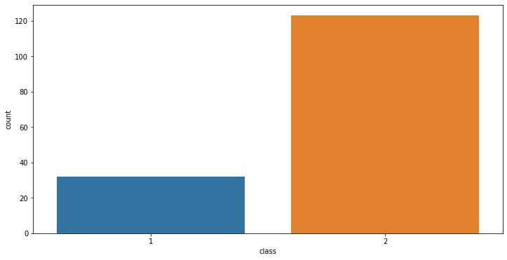
EDA INSIGHTS:

Slide 25
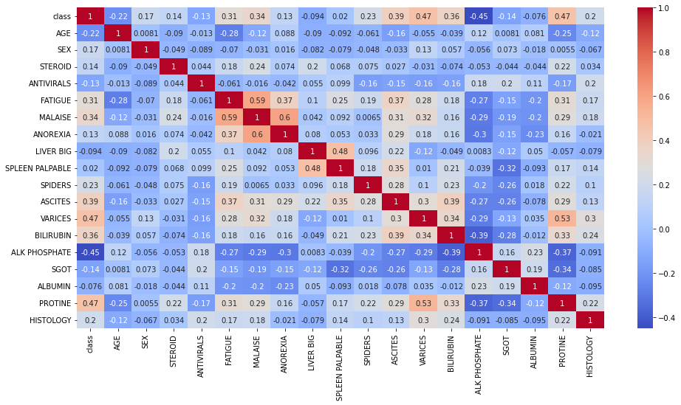
HEAT MAP:

Slide 26
Train & Test proportion:
In train & test split we did experiment with several sizes like (70%,30%), (75%,25%), (80%,20%), (60%,40%)
A total of 216 patients records were used in the analysis.
About 70% of the total data (i.e. 152 patients) were used as
the training set, and 30% (i.e. 64 patients) used for cross
validation.

Slide 27
Model fitting
We fit the model using ANN
Optimizers used in the neural network are SGD & Adam.
Different architectures& epochs considered to get the better estimates.
For evaluating the model we use ACCURACY

Slide 28
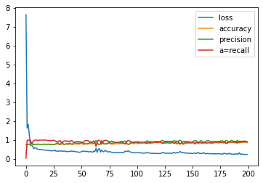
The graph indicates the performance of the artificial neural network model(ANN)

Slide 29
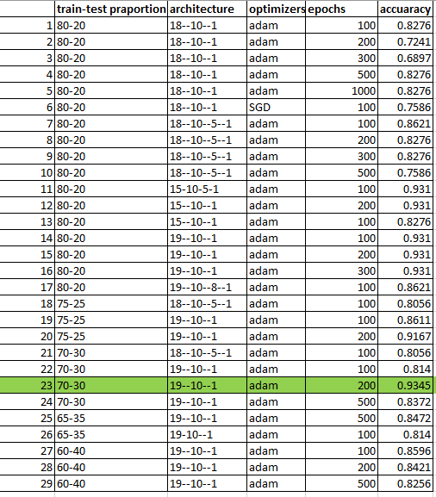
Model tuning
To get the best result we perform lot of experiment by considering different test size , architecture, epochs, optimizers

Slide 30
Conclusion:
An artificial Neural Network model for diagnose patients with hepatitis was presented.
We got the best result for neural network which consists of Single input layer (19inputs), a hidden layer (10 inputs) and a single Output layer
The model was tested and the overall result was 93%.
This study showed the potential of the artificial neural network for diagnoses patients with hepatitis by knowing the probability of survive or death of this patient.

Slide 31

APPENDIX : https://github.com/phanimusunuri1234/hepatitis-neural-network/blob/main/Untitled62.ipynb
https://github.com/phanimusunuri1234/autompg-neural-network/blob/main/autompg_nn.ipynb

